Slide 1
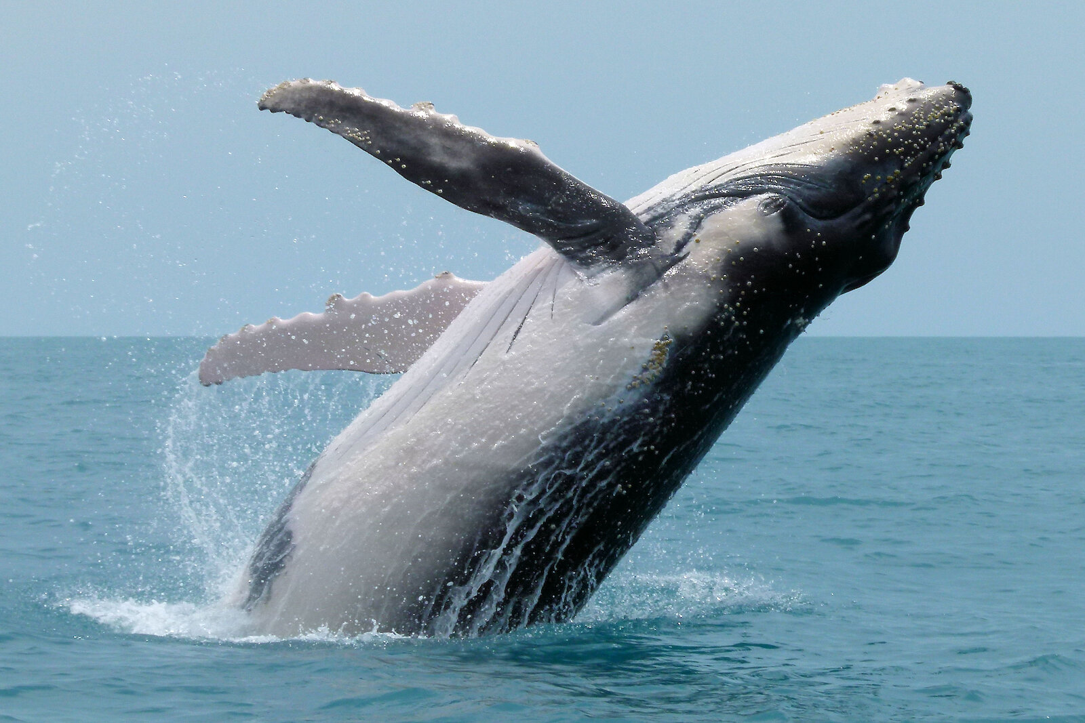
Humpback Whale

Slide 2
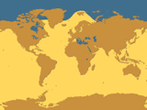
Biome
Humpback whales live in all oceans but are uncommon in artic regions. During summer months they migrate to higher altitudes.

Slide 3

Description
Dark gray to black on their backs
white patterns on their stomach.
Chunky, Heavy bodied
They can weigh 30-40 tons.
They are usually 30-60 feet in length.
Robust body
Fewer throat grooves
Dorsal fin that varies in shape and size
Very long white flippers
Knob- like bumps on head and snout each holding 1 hair
Size related to a bus:

Slide 4
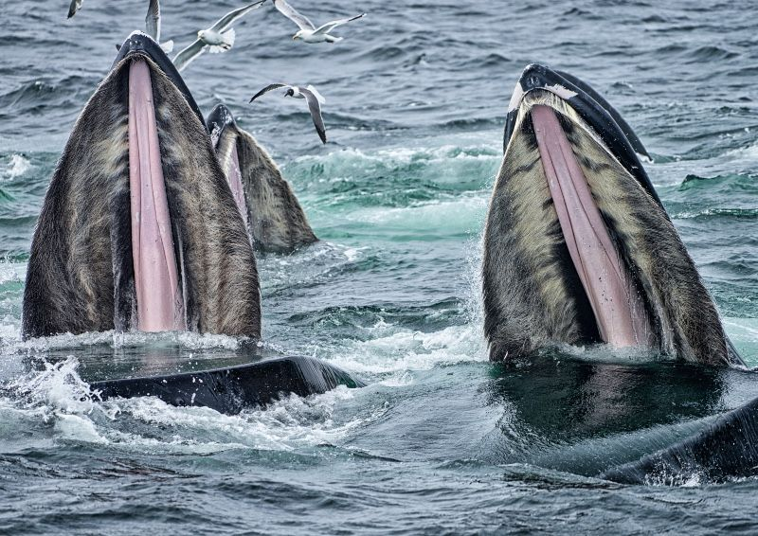
Diet
Humpback whales are omnivores. They will eat:
Tiny shrimplike krill
Plankton
Small fish

Slide 5
Young (Offspring)
Baby humpback whales are called calves. (calf)
They are 15 feet at birth.
Humpback whales calf every year. Sometimes about 2-3 years.
Births between January and March
Gestation takes 11-12 months
Nurses for about 1 year
Don’t stop growing until 10 years old

Slide 6
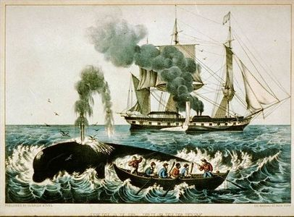
Predators
Humpback whales have only 1 predator, humans.

Slide 7
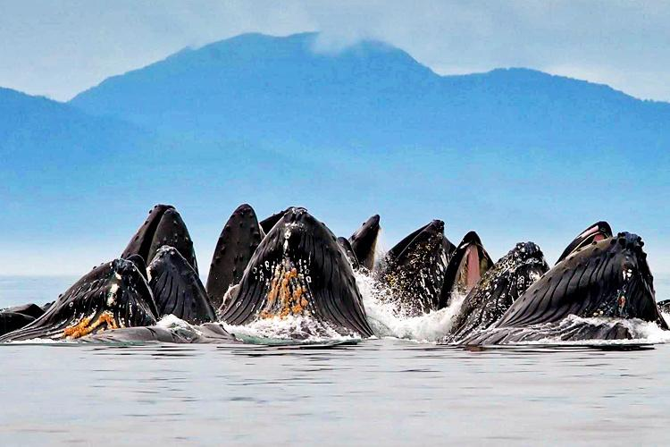
Remaining Population
Status: Endangered
There is an estimated 25,000 to 30,000 left.

Slide 8
Reasons It’s Endangered
Humpback whales are endangered because of:
Whale Hunting (Humans)
Getting tangled in fishing equipment.
Collisions with ships
Acoustic disturbance
Habitat degradation

Slide 9
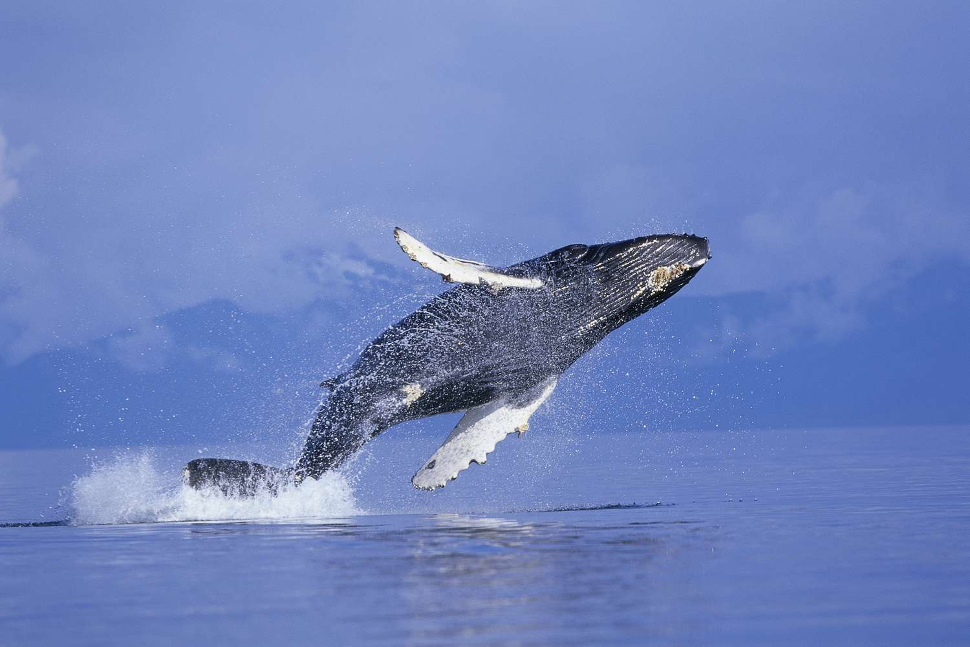
Conservation Measures
Humpback whales gained protection in 1962 through the International Whaling Commission. Since then they have shown signs of recovery in the North Atlantic.

